Slide 1
ICOGEN
INTERNATIONAL CONFERENCE ON GENERAL EDUCATION
Analysis of Motivations and Challenges for Muslim Millennial Parents in Participating in Online Preschool Programs
AUTHOR : 1. Achmad Faqihuddin
2. Faisal Fauzan Ilyasa
AFFILIATES : Universitas Pendidikan Indonesia

Slide 2
ICOGEN
INTERNATIONAL CONFERENCE ON GENERAL EDUCATION
INTRODUCTION
The current trend among Muslim Millennial Parents is the participation in online preschool programs.
Online Preschool is an educational platform or system conducted through the internet, specifically designed for children in the preschool age range of 3-6 years.

Slide 3
ICOGEN
INTERNATIONAL CONFERENCE ON GENERAL EDUCATION
METHOD
This research uses a qualitative approach.
Data obtained through observation, interviews, document studies.
data analysis is performed using NVIVO 12 software

Slide 4
ICOGEN
INTERNATIONAL CONFERENCE ON GENERAL EDUCATION
RESULT

Slide 5
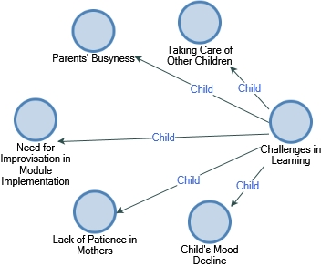
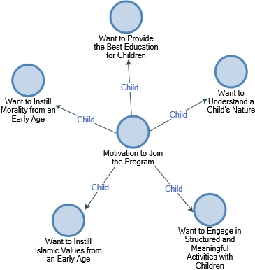
ICOGEN
INTERNATIONAL CONFERENCE ON GENERAL EDUCATION
DISCUSSION

Slide 6
ICOGEN
INTERNATIONAL CONFERENCE ON GENERAL EDUCATION
CONCLUSION
The research findings reveal a variety of motivations for parents participating in online preschool programs, ranging from wanting to provide the best education for their children, instilling noble morals from an early age, to creating structured learning and play activities. Challenges commonly faced by parents include busyness, as well as the loss of children's interest and a decrease in parental patience during the learning process.

